Slide 1
Branded Communications Tools
Tutorial for National Committees

Slide 2
Brand and communications resources
A range of brand and communications materials
Materials are a combination of ready to use and items you will need to support locally
In the 1hr today we want to introduce this material
Friday and open forum
Invest some time after the Session

Slide 3
Brand and communications resources
So, some
can be used right away
Can be customised within constraints
You will need to support or produce locally
Some you can invest a little in and customise further if you choose to


S
$
Notes:
In this presentation we have included the icons with the materials to help guide you

Slide 4
Introducing CIGRE to the world
Notes:
Reinforce the importance of making CIGRE more accessible to lay people and also technical people from differing parts of the changing industry.

Slide 5

$

Slide 7
Our evolved logo


Slide 9
INTERNATIONAL COUNCIL ON LARGE
ELECTRIC SYSTEMS
Notes:
Current approach does not span the full value chain

Slide 10
The foremost global community for the collaborative development and sharing of power system expertise
Notes:
This is an overarching description of who we are

Slide 11
The foremost global community for the collaborative development and sharing of power system expertise
Our descriptor
Our tagline

Slide 12
Our evolved logo – NC versions

Notes:
Show dropbox of files that are ready to use

Slide 13
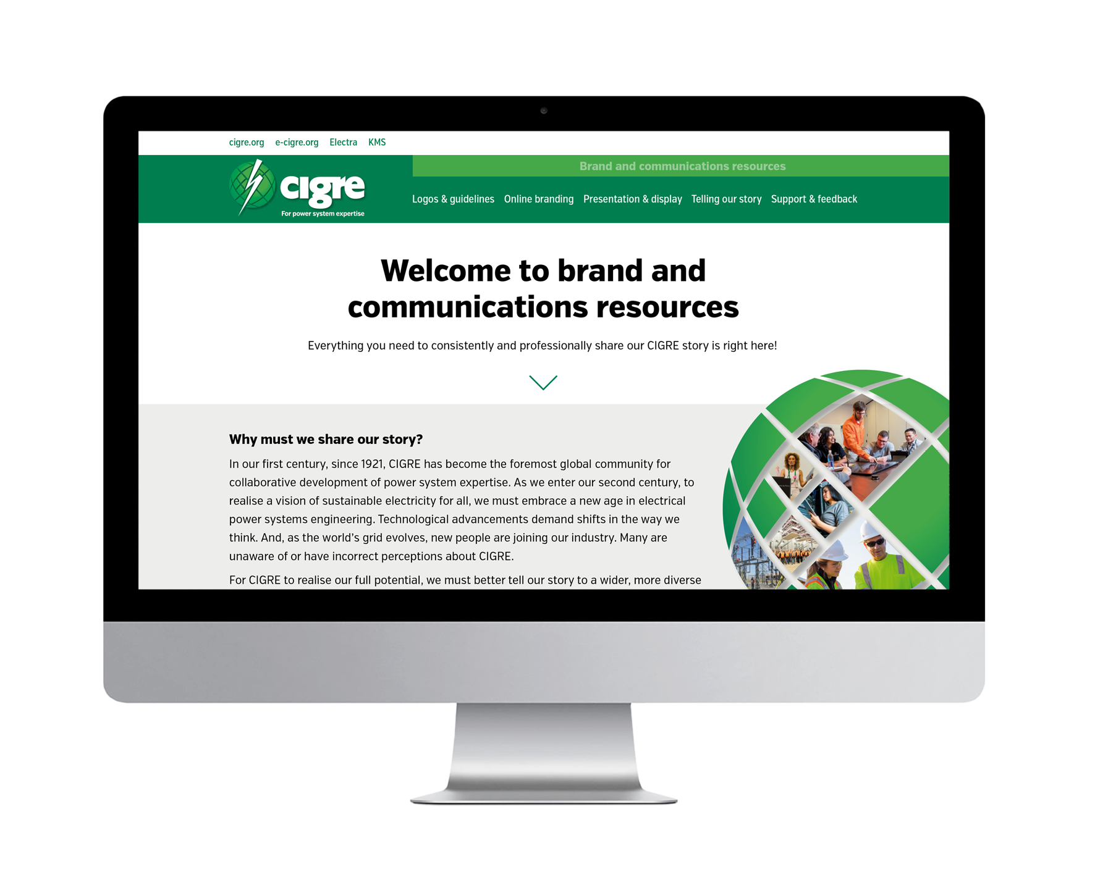
You can source logos and identity guidelines
on the new marketing resources site

Your NC logo can be found at
logos
Notes:
Open the logo guidelines document here and show the NC the guidance on its use, show them the relevant pages on the MR site. Draw attention to page that explains relationship between global and NC Logo.

Slide 14
New rollup screens
S
You can request artwork for local production
Local producers exact specification
We can apply your logo if you wish
You cost is local production the rest is covered
If you wish to translate you can request this too the cost of this change is the NCs
$
$
Notes:
If the NC provides the local producers specifications we will supply artwork for local production, no spec no artwork. This is important as sizes of these vary slightly all over the world and if we provide one generic file it will be reproduced in a low quality way.

Slide 15
Customisable NC profile

Customise to your NC profile template
with a professional designer or Acrobat Pro
Apply your:
logo
photo and join info
links to web
Translation if you wish
There are some limitations!
Notes:
Open the NC profile example and template. This is the one we spend some time on and show them Acrobat Pro. That way later we don’t need to repeat this on the rest of the brochures. Reinforce Acrobat pro has limitations and if they want to do more to this profile they should provide the file to a designer for editing. Support around this item is a local cost.

Slide 16
Customisable intro NC profile

Insert your logo
Change the background image if you wish
Add your name
Translate if you choose too
Add your URL
Notes:
Using ACROBAT Pro demo it

Slide 17
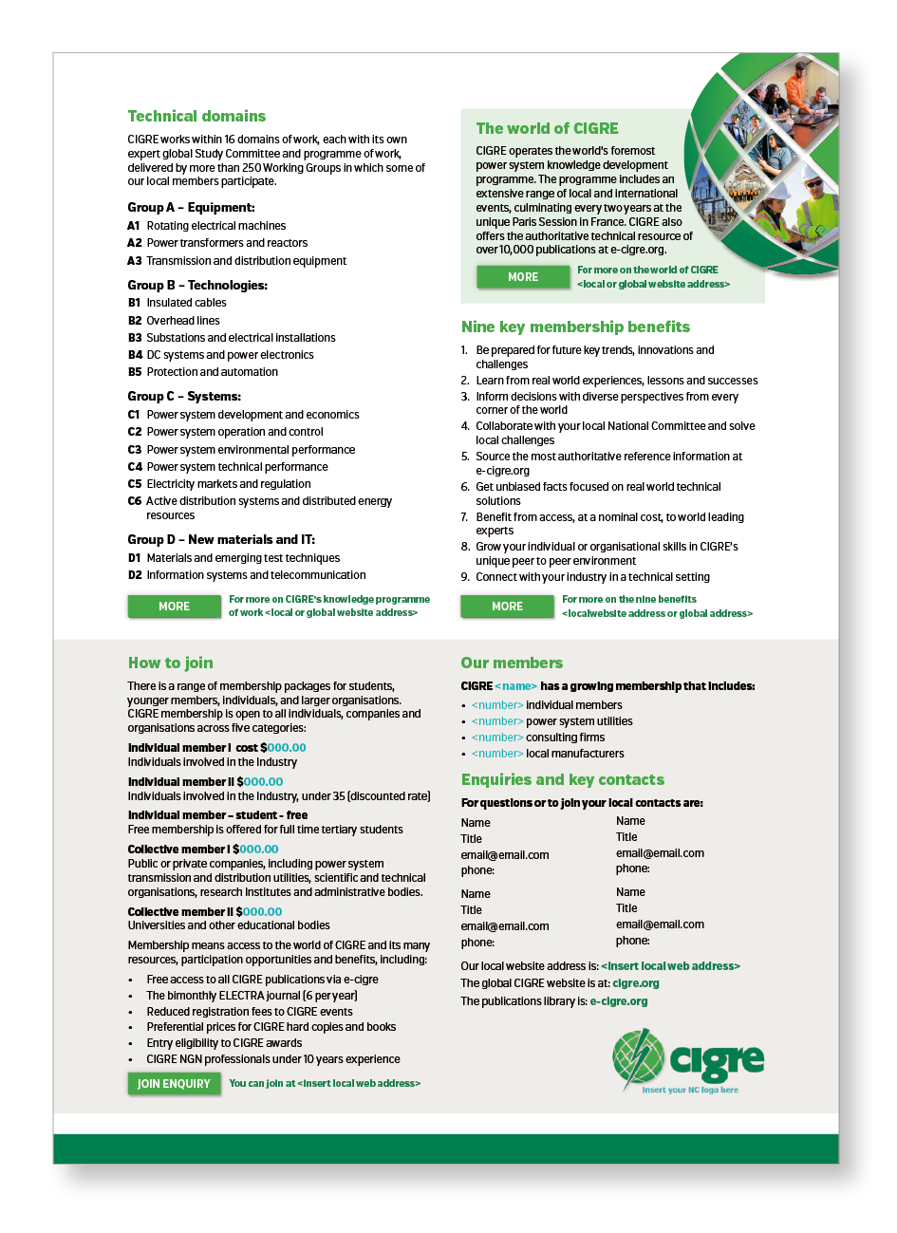
Customisable intro NC profile

Fill in your join info
Add your URLs to the buttons for digital or text for print
Add you key contacts
Insert your logo

Slide 18
Presenting and introducing CIGRE to people
Notes:
Pick up the tablets and demo the intro presenter. Show on the MR site where the ppts are

Slide 19
Presenting and introducing CIGRE to people


Standard PowerPoint presentation on CIGRE available
Also a donut version for insertion in wider presentations
Free to translate these slides and apply your own logos
Online mobile and tablet version as well intropresenter.cigre.org
Notes:
Show where they can find this on the MR site.

Slide 20
Tell the global story of CIGRE with the welcome videos partner global profiles

Slide 21
Tell the global story of CIGRE with the global profiles


Tells the story of the world of CIGRE
Print and digital available of abridged version
Long profile digital only
if you want to translate digital versions editable with acrobat pro
No need to add your own logo to the covers
Perhaps change logo on join page
Also update links to videos and info leaflets if you are embedding them on your own websites
Notes:
Demo short profile here show print example. Explain as shown in the poster the long version is for people who are interested in deeper info on CIGRE.
Refer to the guidelines pdfs here and how to find out more.

Slide 22
For a harder edge to promote the value of membership use these tools


Promote the nine key benefits of CIGRE
Digital pdf versions available can be translated
And have local logo applied
Video sequence

$

Slide 23
Going deeper into the world of CIGRE

Slide 24
CIGRE’s full global profile is meant for someone aware of CIGRE and interested in deeper content
Notes:
Going back to the long profile give a brief tour.

Slide 25
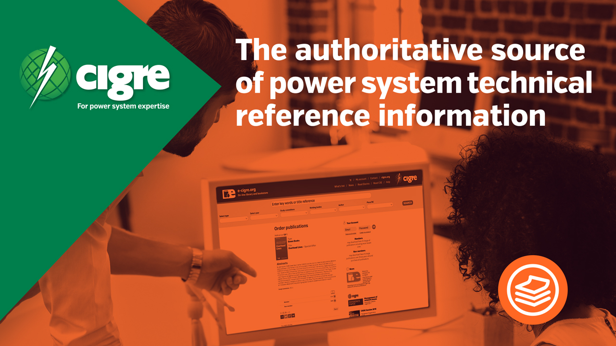
Profile is supported by a short video introducing each of the key areas

Slide 26
Video / Multimedia sequences
$

All videos are available as mp4
And are on our YouTube channels so you can fairly easily embed them in your websites
Already embedded on the NC website template
Also on cigre.org
Customisation is possible but it is NC cost
YouTube subtitles functionality
A full translation of wording starts from NZ$2000

Slide 27
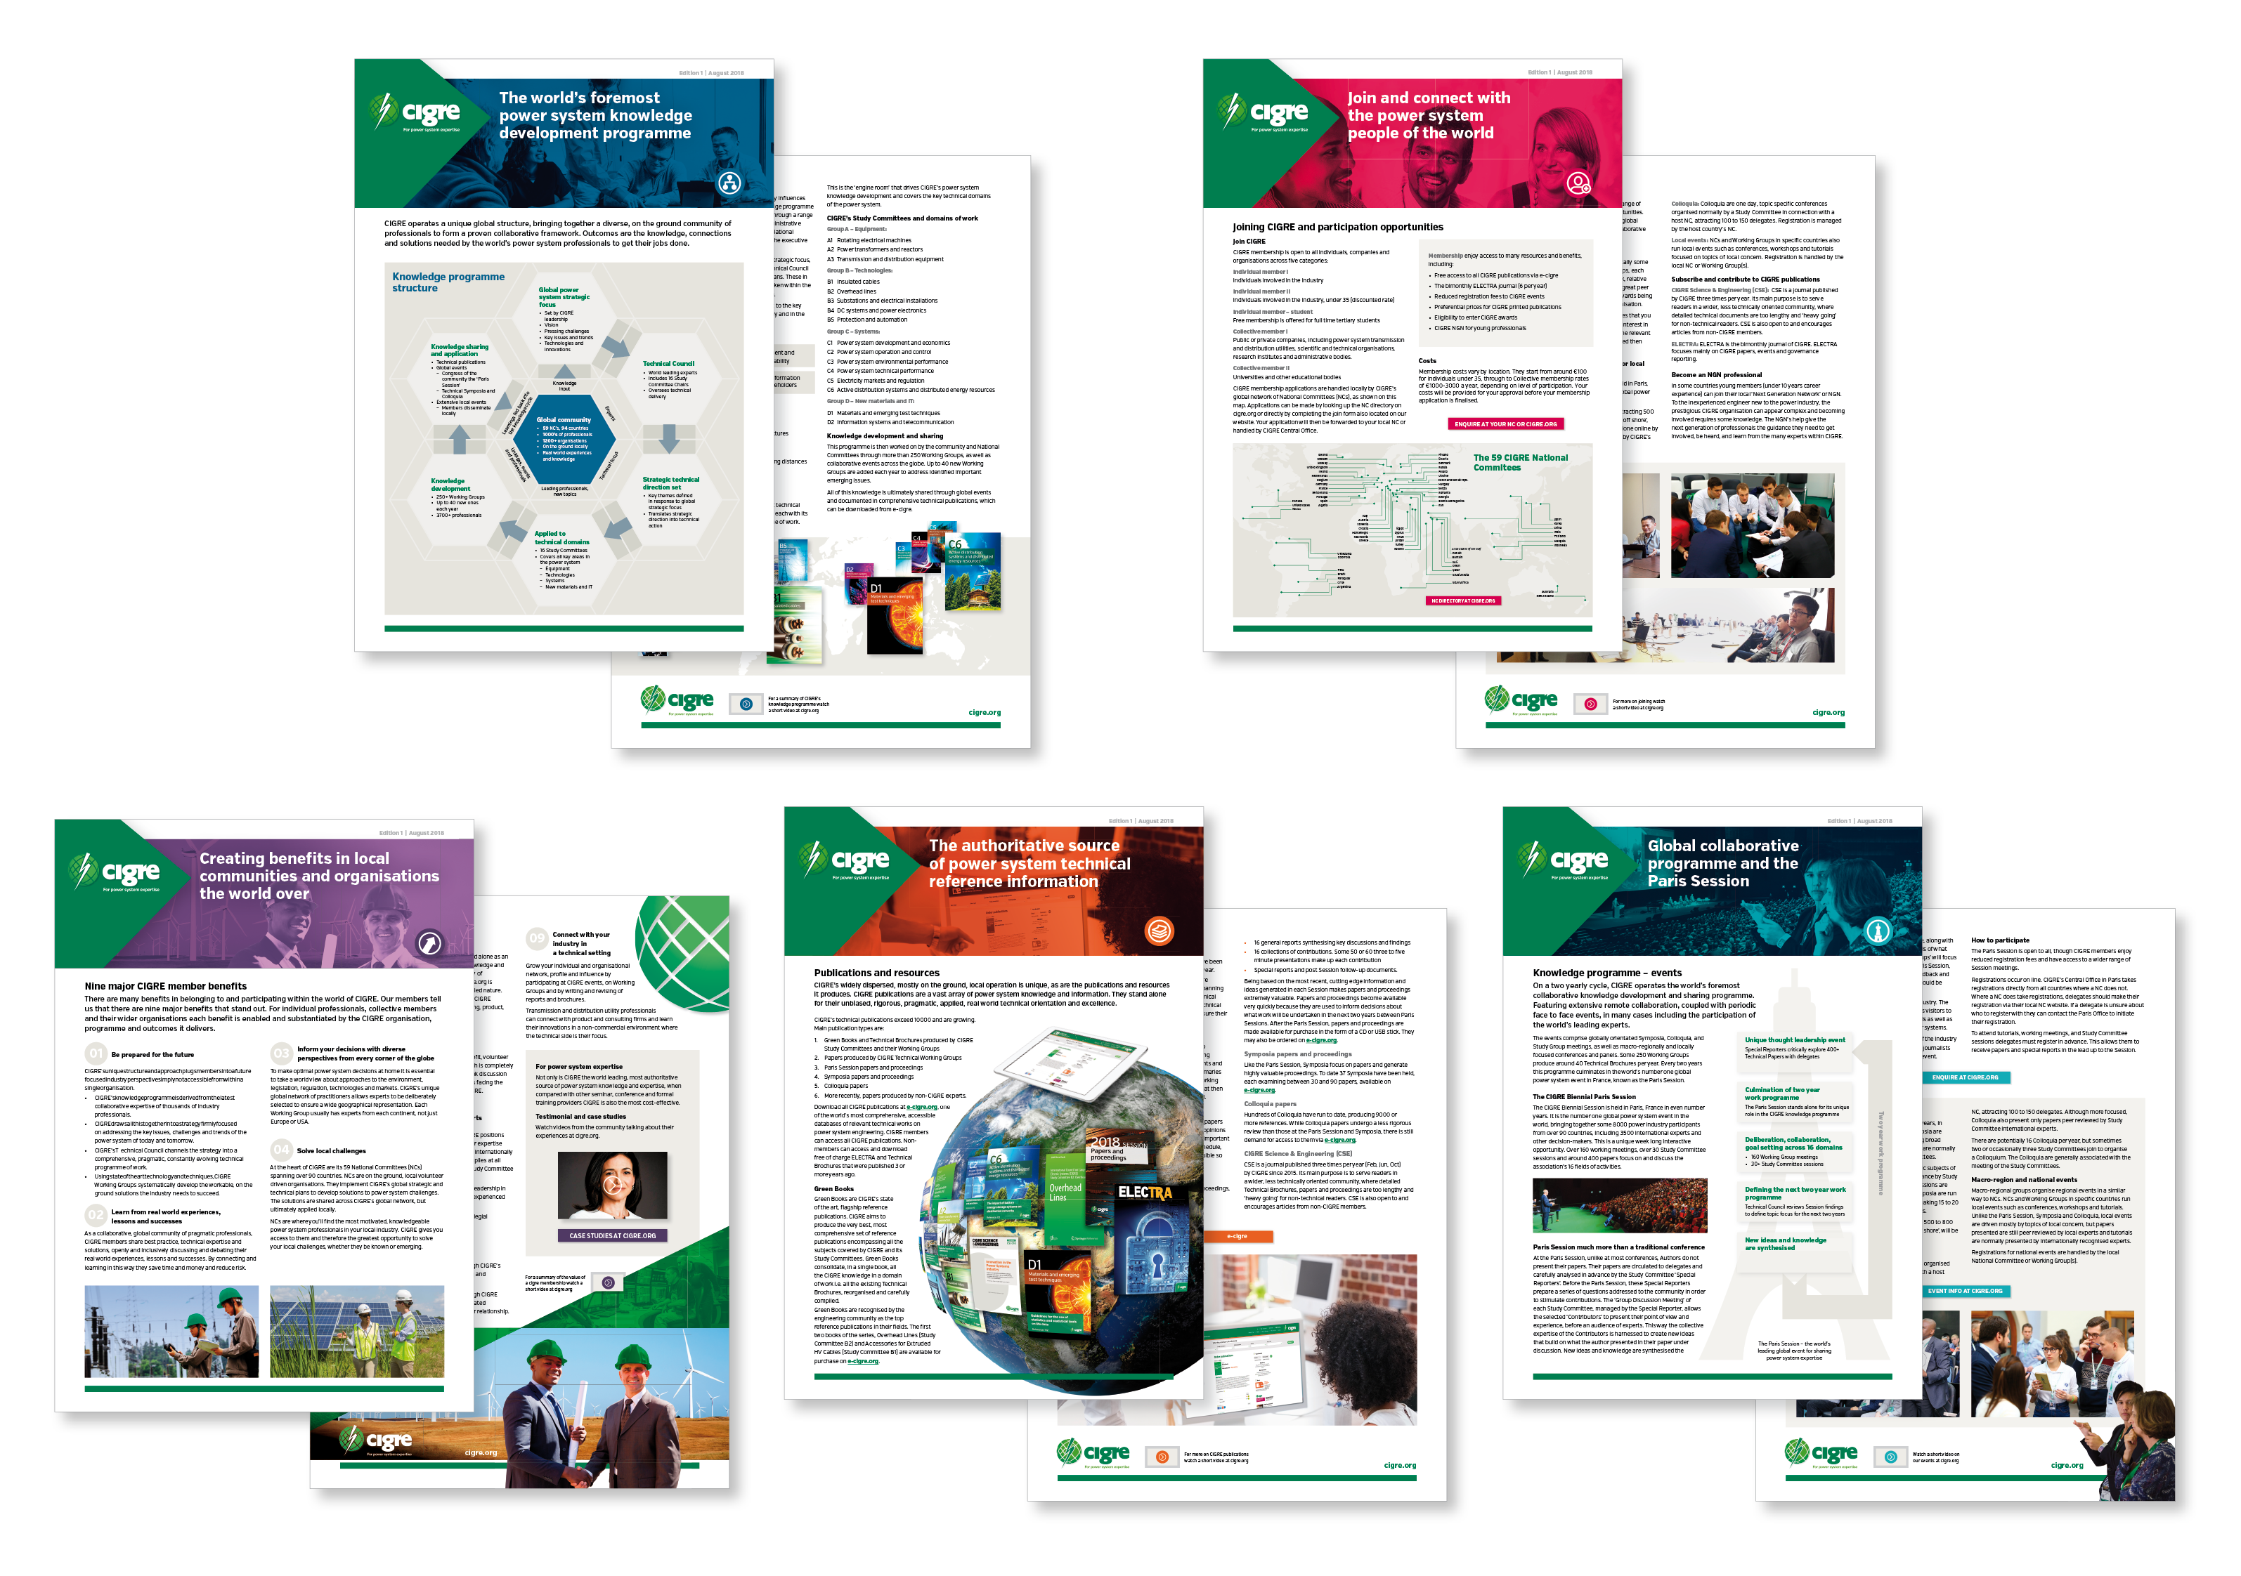
Each video has a partner brochure
These can all be translated and edited to apply you logo and links if you wish


Notes:
Download a brochure from the profile, show them how these are already housed on cigre.org if they just want to link to them i.e. minimal effort.
Show marketing resources site where to find this material.

Slide 28
Supporting branded resources

Slide 29
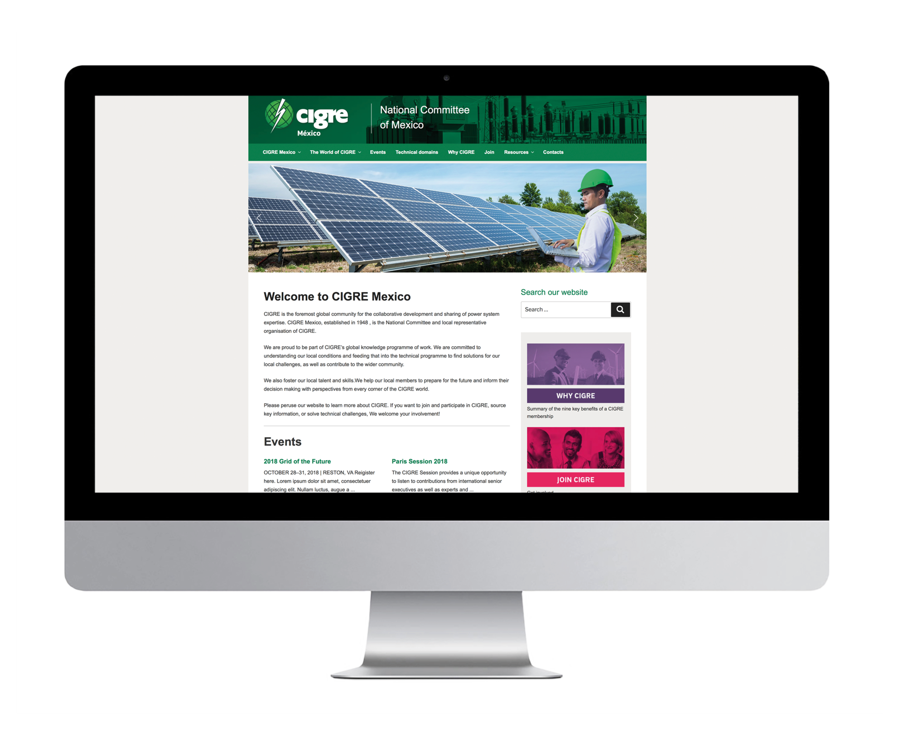
NC website WordPress starter template
Notes:
Open the demo example

Slide 30
NC Website template
$
S
A WordPress starter for 10
Some content pre-populated
Add your own to complete it
You will need to contract a local provider
The template is a starter only
It will need professional support and maintenance
Notes:
Spend some time on this and make sure expectations are managed well here as this is a high risk area. If they are interested in using it give them a copy of the guidelines and be clear the site is an unwarranted starter only. Things will be broken when you download it – set the expectation at this (this is unavoidable)
WordPress Technology is very universal i.e. 30% of the web but it is quite fickle and you need some know-how for it to work well. You download the ZIP and then ask your local developer the cost to setup a site by updating the template with the latest security plugins and ensuring its stable.
C.O and Aspire is not supporting this but will update the template annually.

Slide 31
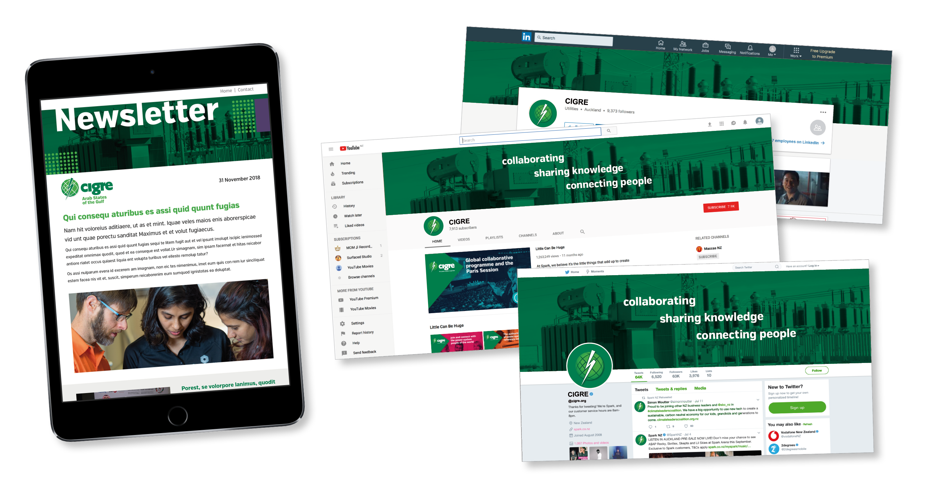
Social media banners & email marketing template
S
$
Notes:
The email newsletter is a psd file. If they want to set one up this resource can have their logo applied and then they can set it up with some knowledge needed using one of the global email engines such as mail chimp or campaign monitor. These cheap universal services require some investment of time and money to get setup.

Slide 32
Branded stationary
Standard ppt, business card template, letterhead
S
$
Notes:
Mention that business cards are a professional design file to provide to your printer for local update of details. The PowerPoint and word documents are ready to use.

Slide 34
Brand and communications resources - summary
You can find everything at the MR site
You can request support but in some cases you have to pay for it
All support requests are directed to Central Office
If you want to use the web template you need to contract a local supplier
As is the email template a PSD file to provide to a local supplier
But all of this is consistently presenting the amazing story of CIGRE

Slide 35
Brand and communications resources - summary
What’s next – help us on case studies and testimonials!
Materials will be updated annually, you can submit suggestions
Watch this space for action orientated campaigns
Help us to make match CIGRE’s technical excellence with a world class global brand
Email you NC logo links / PDF of these screens
Thank you!

